Slide 1
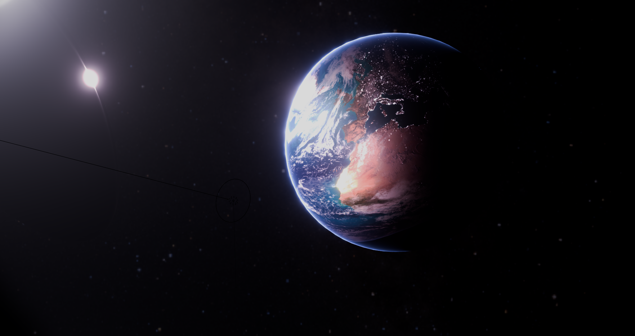
Project Elara
A technical introduction
Jacky Song, Milo Schnack, Emiliano Vilchis, Charles Wang, Nicholas Schnorbus
Rensselaer Polytechnic Institute

Slide 2
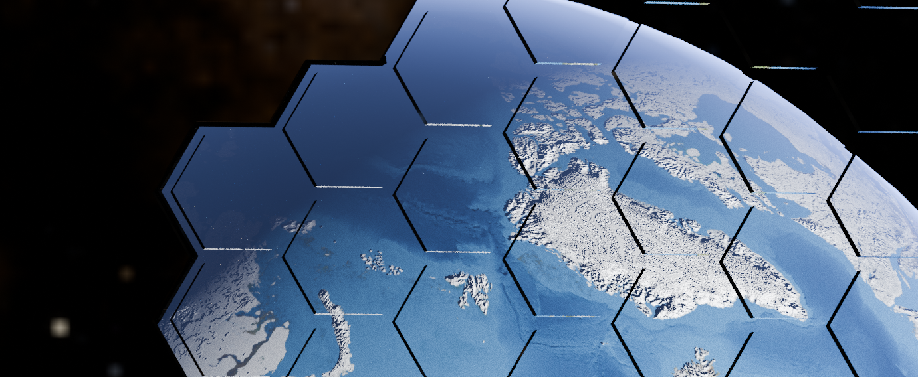
What is (and why) space-based solar power?
Credit: Milo Schnack

Slide 3
Motivation and overview
At orbit, the Sun provides a consistent power output of 1.36 kW/m²
Near-continuous sunlight 24 hours/day for most days in the year
Massive source of free and untapped energy!
Advantages:
Reliable (unaffected by weather, available even at night and during storms)
High power potential (full exposure to sunlight, no cloudy days)
Can be made huge without taking up space/land on Earth (and the associated problems with displacing people/destroying habitats)

Slide 4
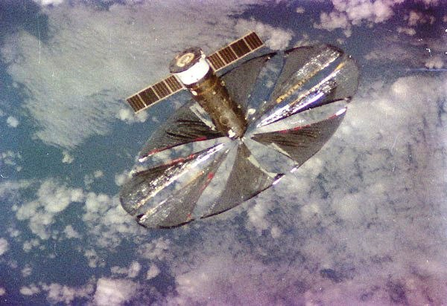
Motivation and overview
One 16-meter radius (ideal) solar collector mirror can provide 1 MW of power
Not a new technology – Znamya satellite (by former USSR) demonstrated a 10-meter radius solar mirror (but for a different purpose) in 1992!
A (vast) constellation of solar power satellites can provide more than enough energy to power the Earth!
Top: Znamya satellite, fully deployed

Slide 5
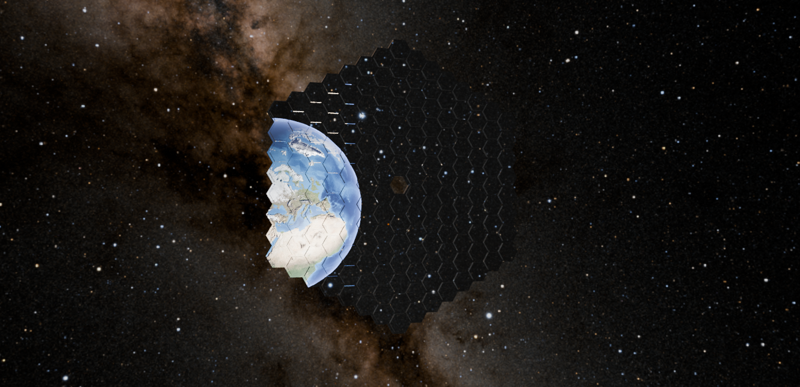
Our preliminary design
Credit: Milo Schnack

Slide 6
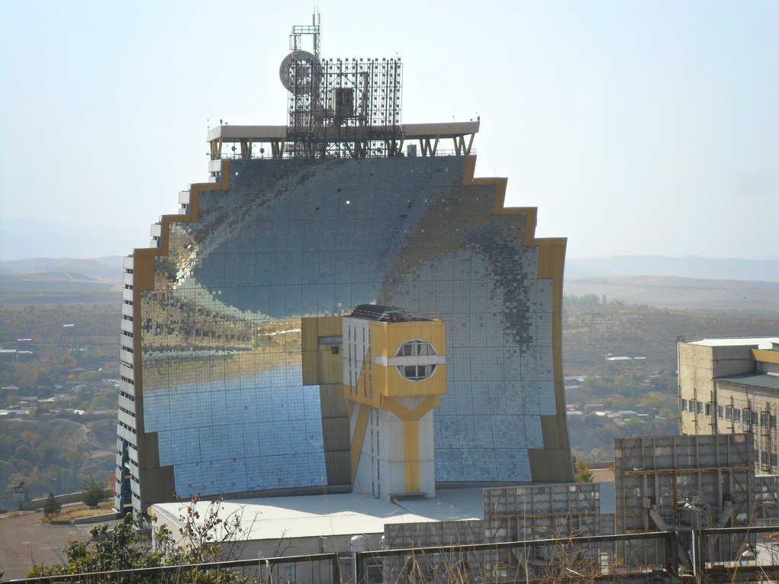
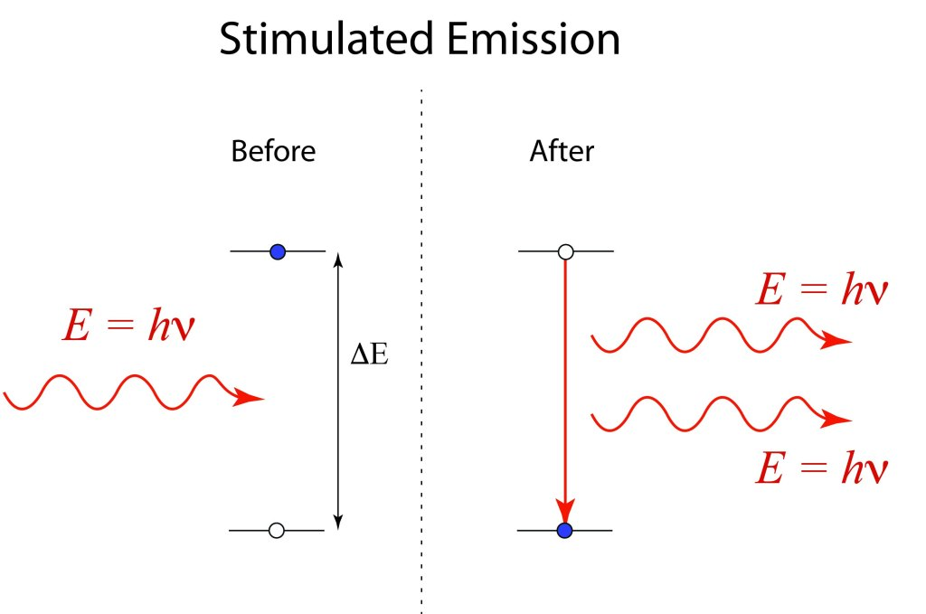
Our concept design
Large but thin and non-rigid solar mirror concentrates sunlight
Concentrated sunlight is used to optically-pump laser (excite atoms to emit microwaves)
Top: Uzbekistan solar furnace, whose design served as an inspiration for the concept space mirror
Left: Diagram of laser emission process

Slide 7
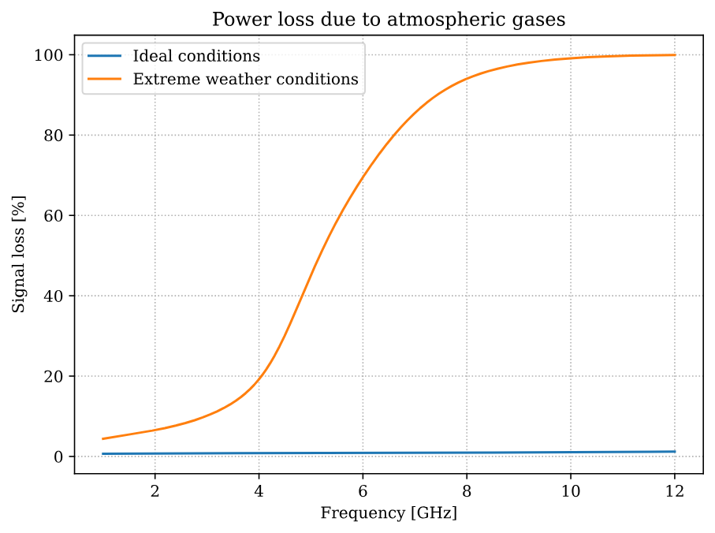
Our concept design
Laser is tuned to create 1-2 GHz microwaves to transmit to Earth
This frequency minimizes power loss to <10% (even in really bad weather) and passes relatively easily through the atmosphere regardless of weather conditions
Earth receivers convert received microwaves to AC power
Top: plot of signal loss through the atmosphere across varying frequencies

Slide 8
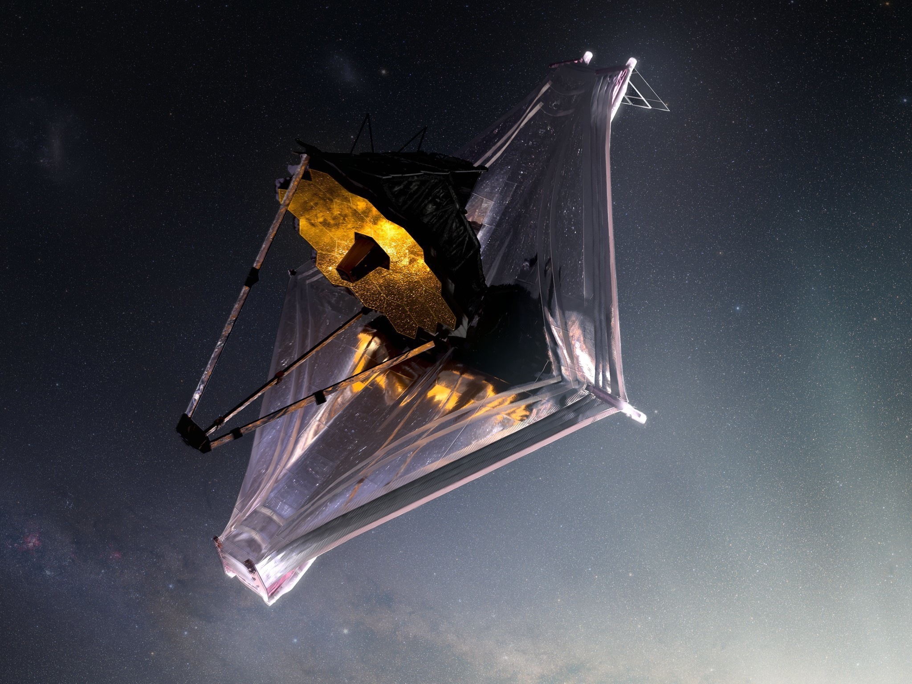
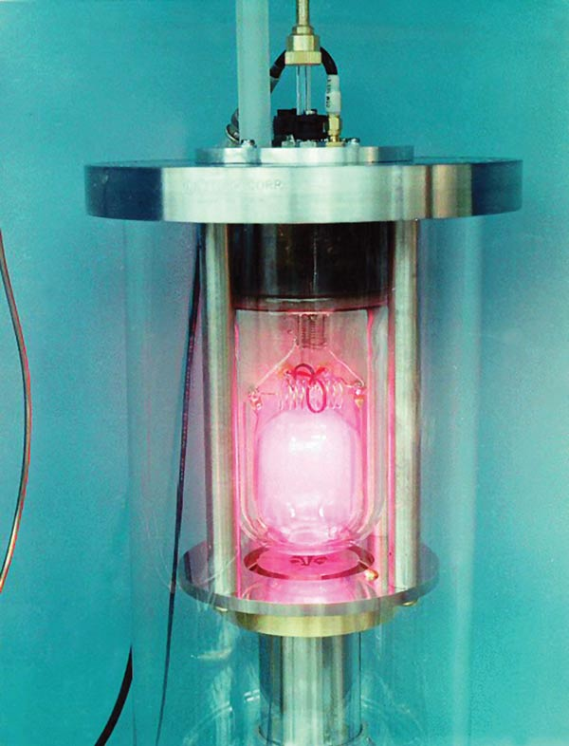
Our concept design
We plan to develop molecular gas lasers that are specialized for high-power microwave transmission
Mirrors are adapted from the technology used in sunshields e.g. from JWST
All technologies developed (both software and hardware) will be open-sourced
We hope to build a prototype to launch into space with the RPI Spaceflight Society
Top: JWST sunshield, bottom: ammonia gas maser (maser = microwave laser)
Notes:
Talk about ammonia maser as the first laser invented - nanowatt capability only - as a joke talk about how the person who invented it was laughed at before he made it (“it’s impossible and you’re stupid!”) and then after he invented it, people were like (“that’s obvious, it’s so simple”) and “see this shows how supportive physicists are”

Slide 9
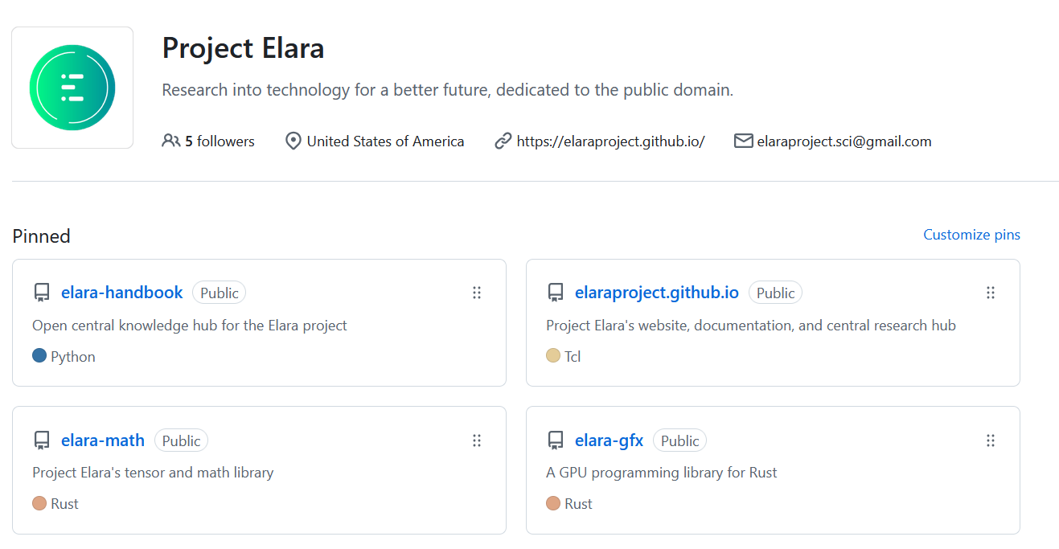
All source code and documentation is available on our GitHub:
github.com/elaraproject

Slide 10
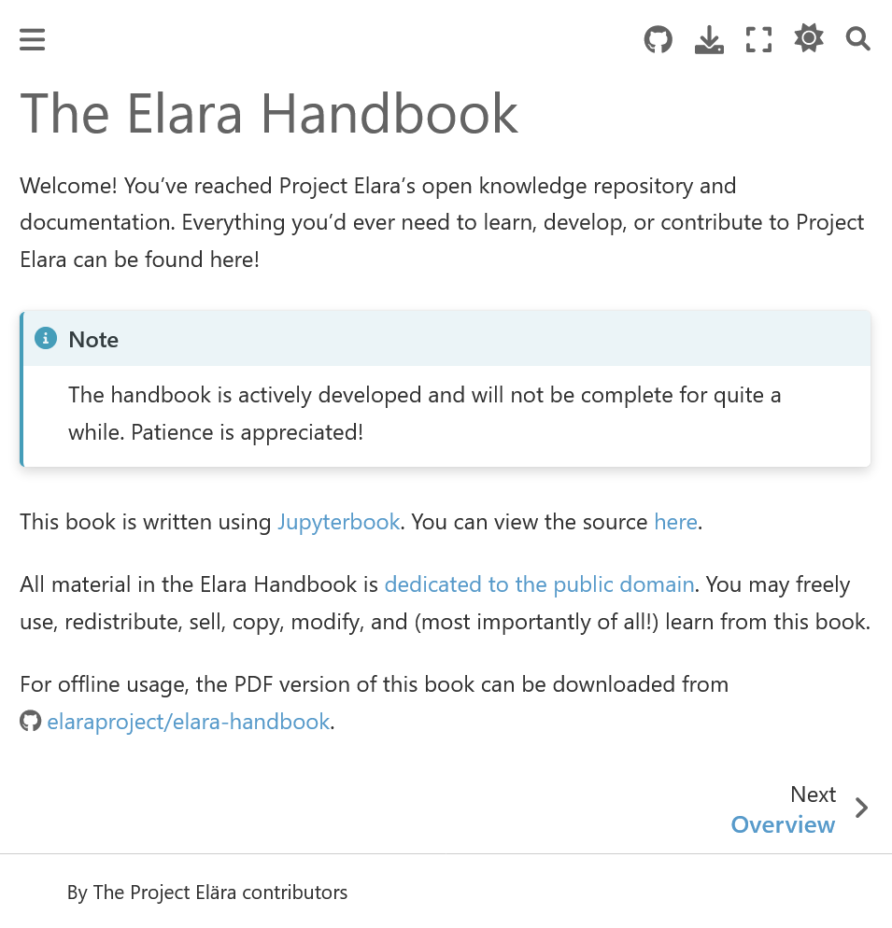
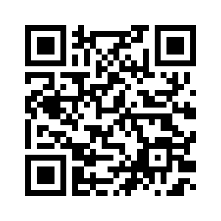
We have a free online book to document our work:
Scan here:
Or enter:
tinyurl.com/elara-handbook

Slide 11
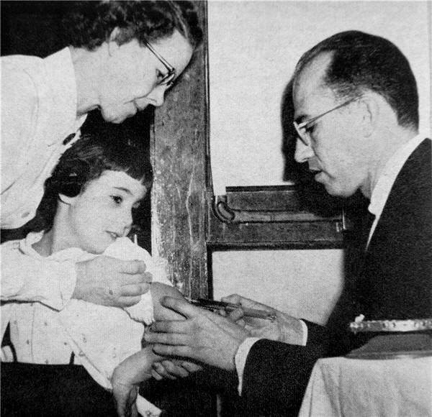
Inspire.
Hope.
Dream.
Jonas Salk (1914 - 1995)
inventor of the polio vaccine, who gave it away for free for all humankind - our inspiration
Notes:
Talk about how this isn’t just something we do because we think it’s cool, but because we want to make clean, sustainable, and affordable energy available to everyone. We do this not for ourselves, but for our future generations to live a better life one day. And we absolutely uninterested in profit, we want to make it the lowest cost possible (and if it becomes practical, for free) and release everything we do into the public domain (so that no one can patent it and make it proprietary for themselves).
Talk about Jonas Salk (inventor of polio vaccine). Also talk about what elara means - “hope”

Slide 12
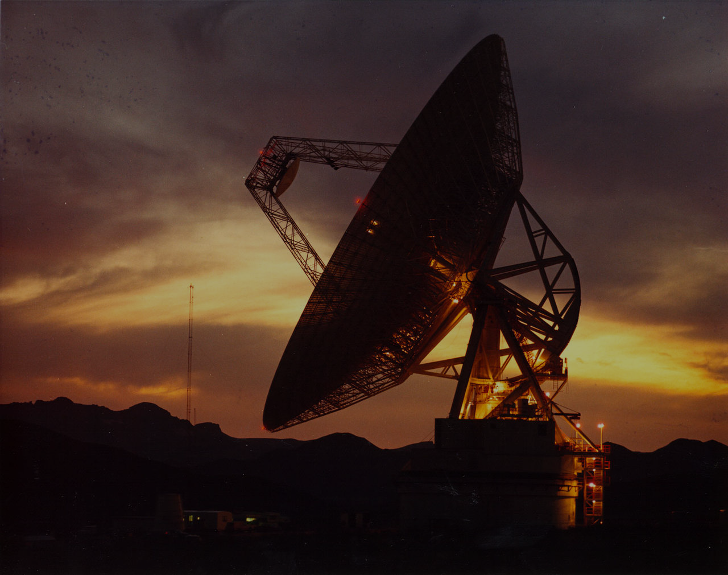


Why not change the world?
Note: Project Elara is not an official project of Rensselaer Polytechnic Institute.
P R O J E C T E L A R A
Credit: NASA Deep Space Network

